Slide 1
Housing Price Prediction Analysis

Slide 2
House price prediction
PREDICTORS
DWELL_TYPE
ZONE_CLASS
LOTFRONTAGE
LOTAREA
ROAD_TYPE
ALLEY
PROPERTY_SHAPE
LANDCONTOUR
UTILITIES
LOTCONFIG
LANDSLOPE
NEIGHBORHOOD
CONDITION1
CONDITION2
DWELLING_TYPE
HOUSESTYLE
OVERALLQUAL
OVERALLCOND
YEARBUILT
YEARREMODADD
ROOFSTYLE
ROOFMATL
EXTERIOR1ST
EXTERIOR2ND
MASVNRTYPE
MASVNRAREA
EXTERQUAL
EXTERCOND
FOUNDATION
BSMTQUAL
BSMTCOND
BSMTEXPOSURE
BSMTFINTYPE1
BSMTFINSF1
BSMTFINTYPE2
BSMTFINSF2
BSMTUNFSF
TOTALBSMTSF
HEATING
HEATINGQC
CENTRALAIR
ELECTRICAL
1STFLRSF
2NDFLRSF
LOWQUALFINSF
GRLIVAREA
BSMTFULLBATH
BSMTHALFBATH
FULLBATH
HALFBATH
BEDROOMABVGR
KITCHENABVGR
KITCHENQUAL
TOTRMSABVGRD
FUNCTIONAL
FIREPLACES
FIREPLACEQU
GARAGETYPE
GARAGEBLT
GARAGEFINISH
GARAGECARS
GARAGEAREA
GARAGEQUAL
GARAGECOND
PAVEDDRIVE
WOODDECKSF
OPENPORCHSF
ENCLOSEDPORCH
THRSSNPORCH
SCREENPORCH
POOLAREA
POOLQC
FENCE
MISCFEATURE
MISCVAL
MOSOLD
YRSOLD
SALETYPE
SALECONDITION

Slide 3
Challenges in the Project/Data
First Challenge is to handle that large data for us at first time.
Also face difficulty to understand that all columns with null values.
Also Face Problem Preparing Power Point Presentation.

Slide 4
Major Findings through EDA
Some Columns Have Null Values
Some Null Values Meaning is different like there is not required that thing, Like Garage Type, Pool Quantity, etc…..
Outlier are also available
And we treat that outlier as per Data requirement
Also facing correlation value in positive and negative to judge for Good Or Bad Predictors.
We Face some difficulty in merge categories

Slide 5
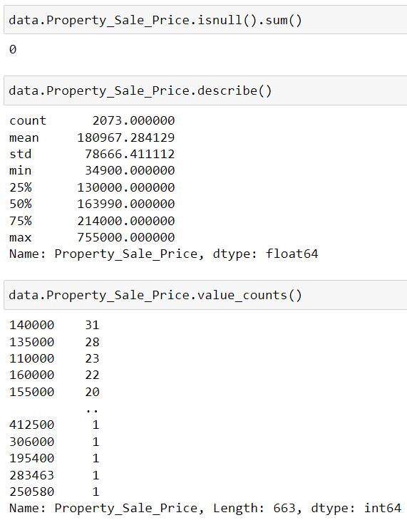
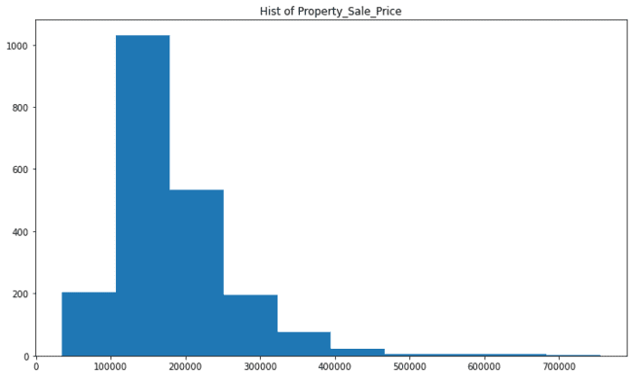
Response / Target Variable Property_Sale_Price
Continuous Variable

Slide 6
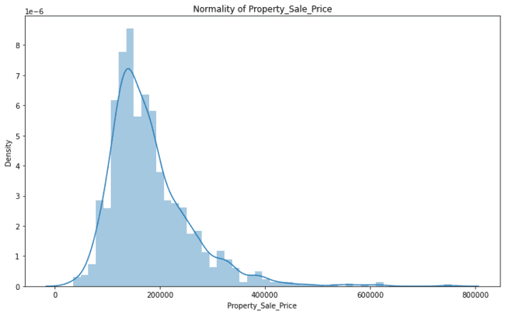
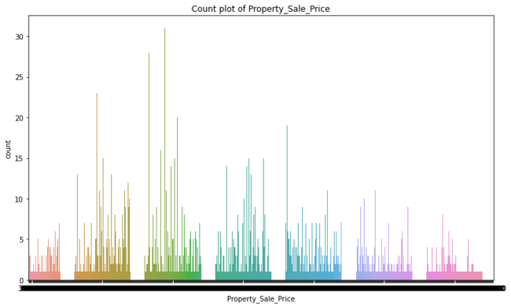
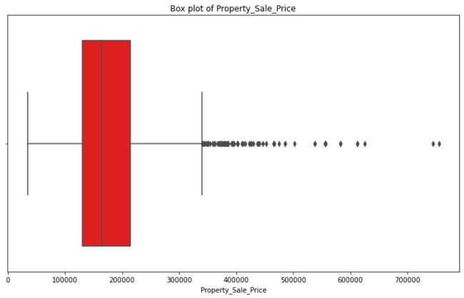

Slide 7
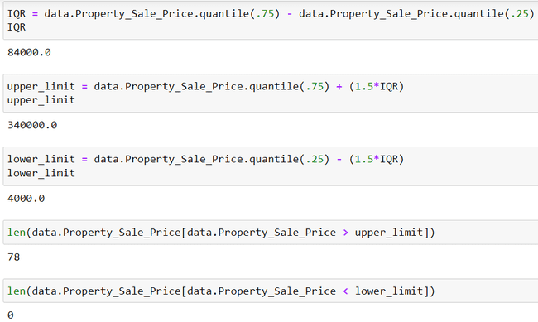
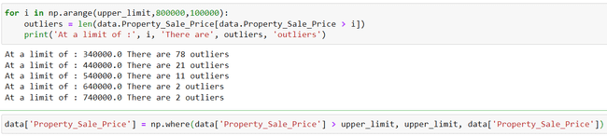
Outlier Treatment

Slide 8
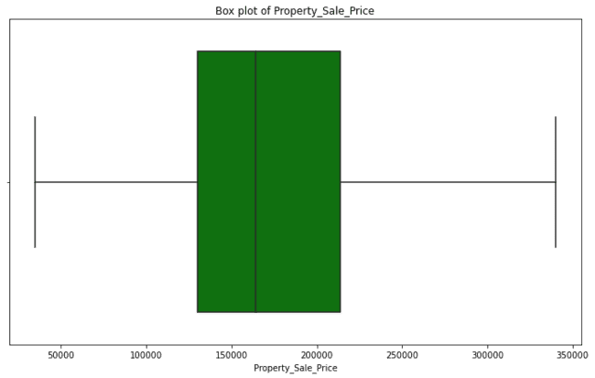
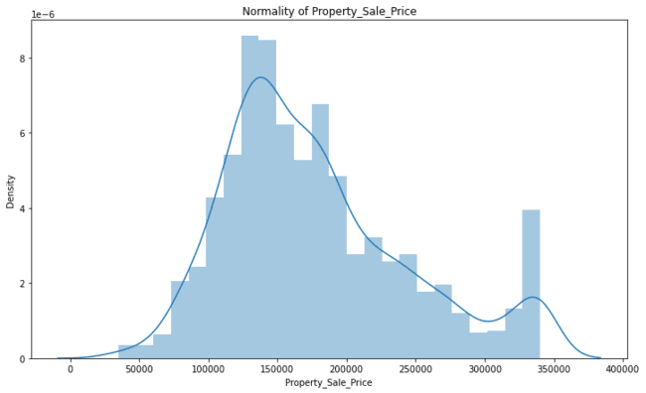
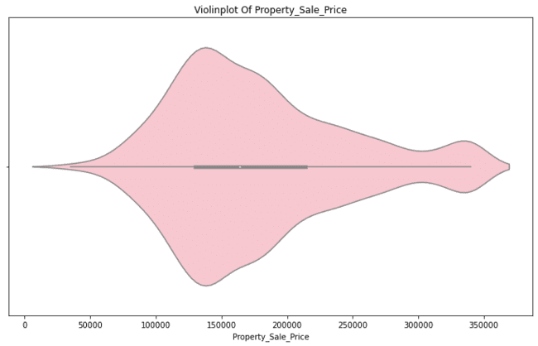

Slide 9
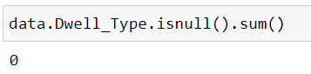
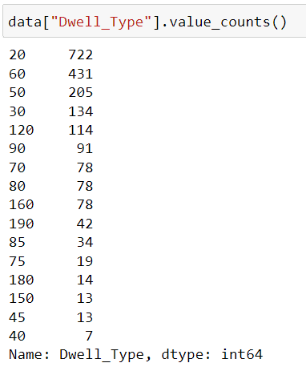
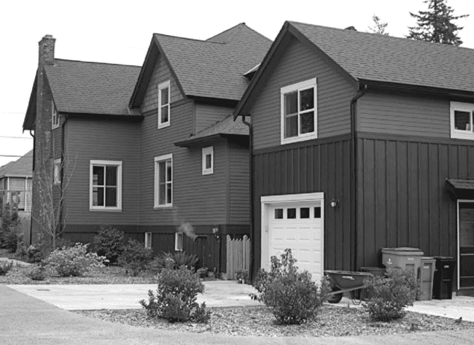
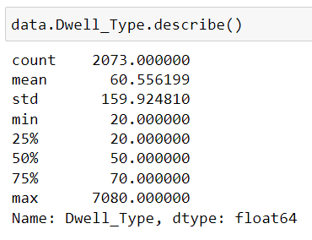
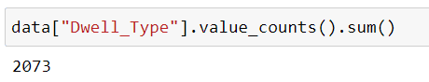
1. DWELL_TYPE
Categorical Variable

Slide 10
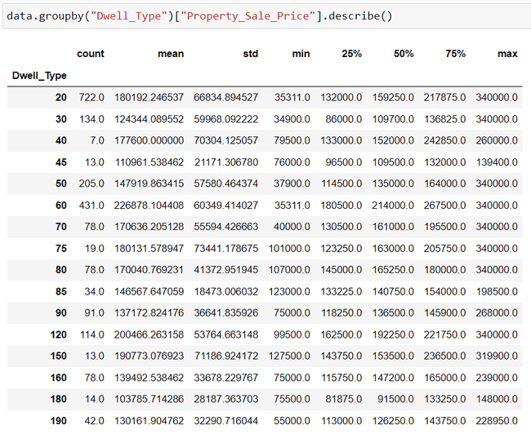
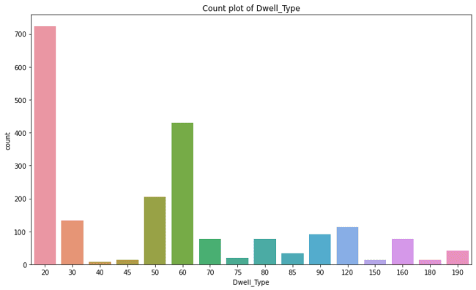

Slide 11
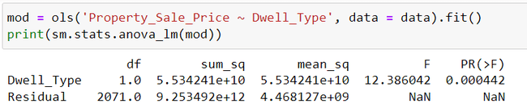
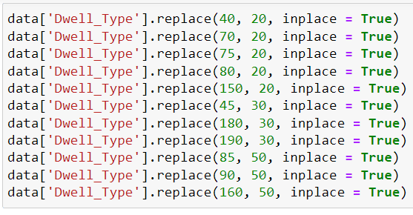
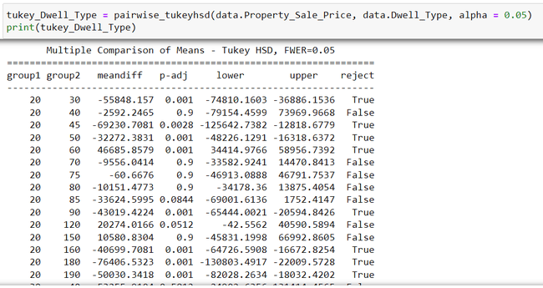
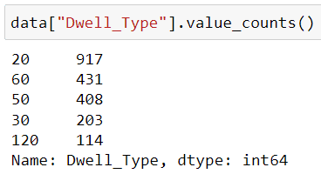
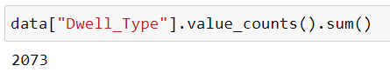

Slide 12
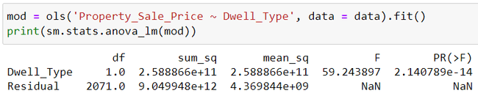
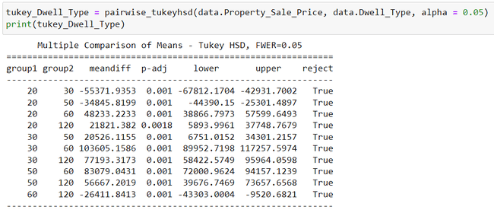
Good Predictors

Slide 13
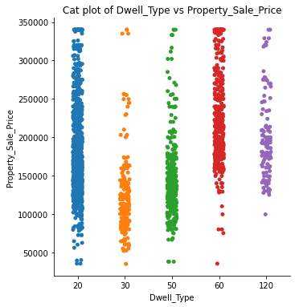
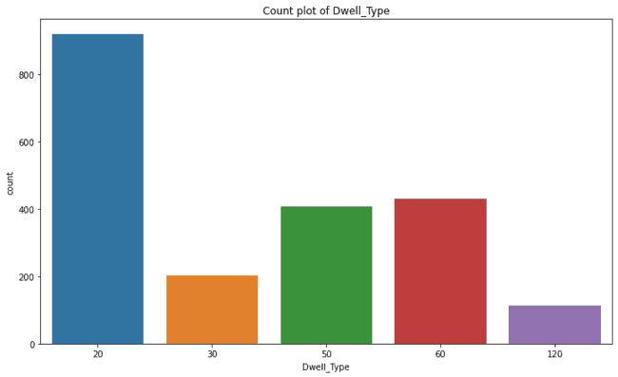

Slide 14
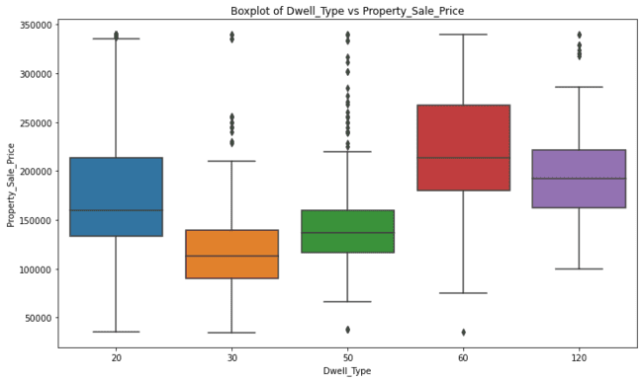

Slide 15
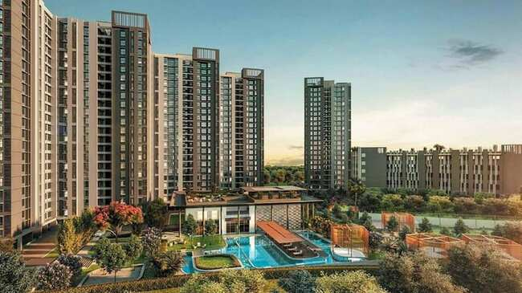
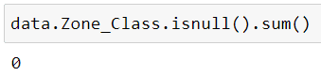
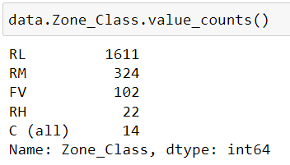
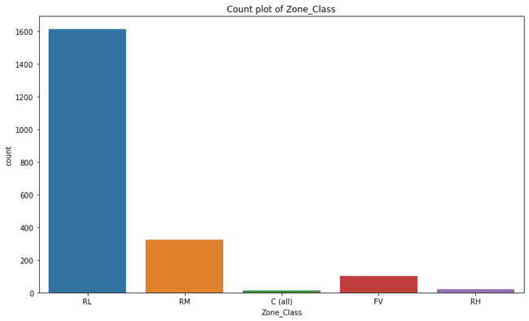
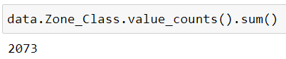
2. ZONE_CLASS
Categorical Variable

Slide 16
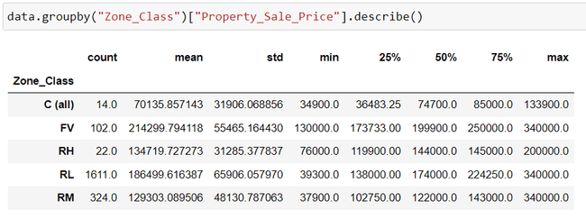
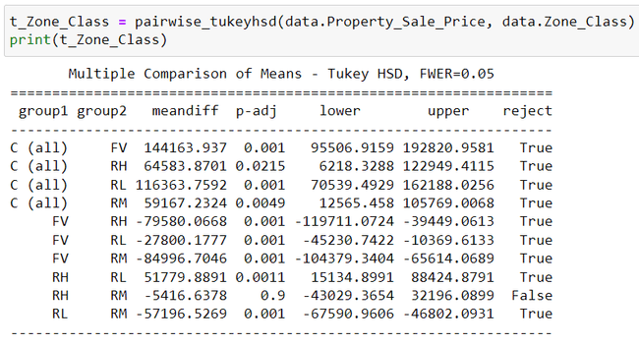
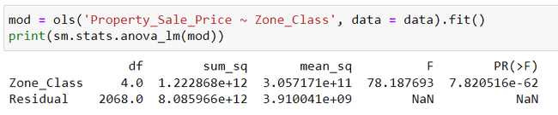

Slide 17
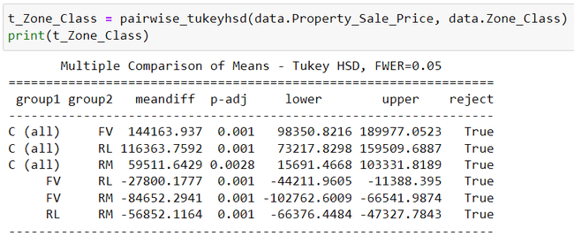
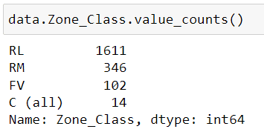
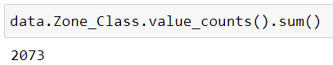
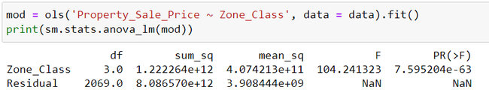
Good Predictor

Slide 18
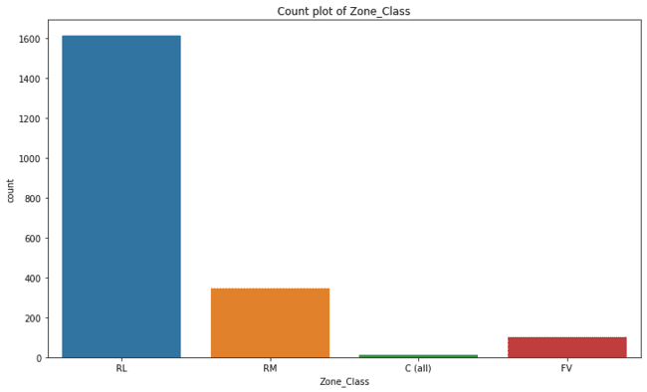
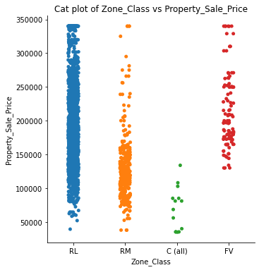

Slide 19
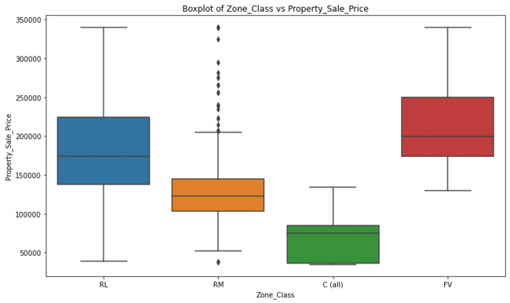

Slide 20
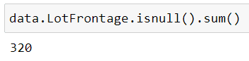
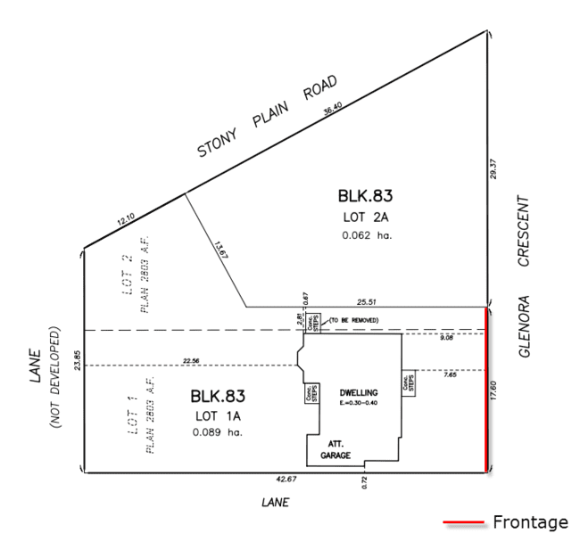
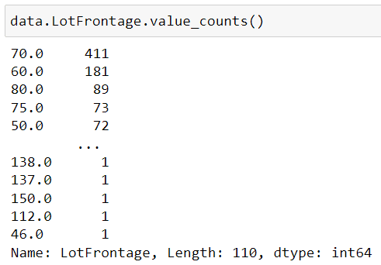
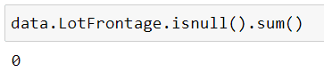
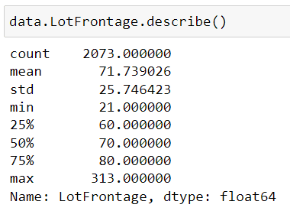
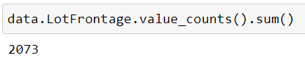
3. LOTFRONTAGE
Continuous Variable

Slide 21
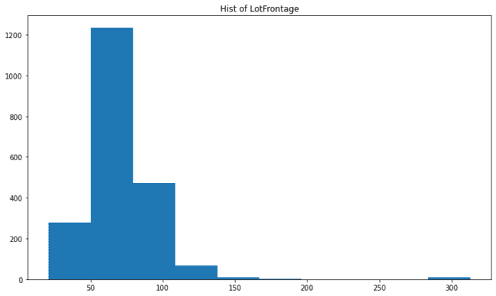
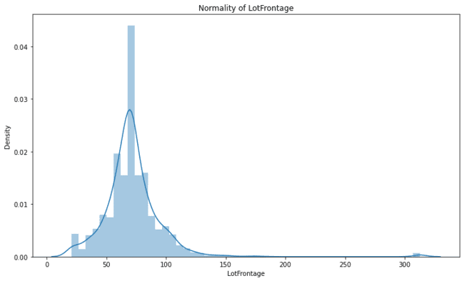

Slide 22



Slide 23





Slide 24



Slide 25


Not Good Predictor

Slide 26





4. LOTAREA
Continuous Variable

Slide 27



Slide 28





Slide 29



Slide 30



Slide 31


Not Good Predictor

Slide 32




5. ROAD_TYPE
Categorical Variable

Slide 33

Good Predictor

Slide 34




6. ALLEY
Categorical Variable

Slide 35





Good Predictor

Slide 36



Slide 37


Slide 38



7. PROPERTY_SHAPE
Categorical Variable

Slide 39





Slide 40



Good Predictors

Slide 41



Slide 42



8. LANDCONTOUR
Categorical Variable

Slide 43


Good Predictors

Slide 44




Slide 45



9. UTILITIES
Categorical Variable
Not Good Predictors

Slide 46




10. LOTCONFIG
Categorical Variable

Slide 47



Good Predictors

Slide 48



Slide 49



11. LANDSLOPE
Categorical Variable

Slide 50

Not Good Predictors

Slide 51



12. NEIGHBORHOOD
Categorical Variable

Slide 52



Good Predictors

Slide 53



Slide 54



Slide 55




13. CONDITION1
Categorical Variable

Slide 56



Good Predictors

Slide 57



Slide 58



14. CONDITION2
Categorical Variable

Slide 59



Good Predictors

Slide 60



Slide 61




15. DWELLING_TYPE
Categorical Variable

Slide 62



Good Predictors

Slide 63



Slide 64




16. HOUSESTYLE
Categorical Variable

Slide 65



Good Predictors

Slide 66



Slide 67




17. OVERALLQUAL
Categorical Variable

Slide 68



Good Predictors

Slide 69




Slide 70



18. OVERALLCOND
Categorical Variable

Slide 71




Good Predictors

Slide 72



Slide 73




19. YEARBUILT
Continuous Variable

Slide 74



Slide 75



Slide 76


Not Good Predictors

Slide 77




20. YearRemodAdd
Continuous Variable

Slide 78



Slide 79


Not Good Predictors

Slide 80




21. RoofStyle
Categorical Variable

Slide 81



Good Predictors

Slide 82



Slide 83




22. RoofMatl
Categorical Variable

Slide 84



Good Predictors

Slide 85



Slide 86




23. Exterior1st
Categorical Variable

Slide 87



Good Predictors

Slide 88



Slide 89


24. Exterior2nd
Categorical Variable

Slide 90



Good Predictors

Slide 91




Slide 92



25. MasVnrType
Categorical Variable

Slide 93



Good Predictors

Slide 94



Slide 95




26. MasVnrArea
Continuous Variable

Slide 96



Slide 97



Slide 98


Not Good Predictors

Slide 99




27. ExterQual
Categorical Variable

Slide 100




Good Predictors

Slide 101



28. ExterCond
Categorical Variable

Slide 102



Good Predictors

Slide 103



Slide 104




29. Foundation
Categorical Variable

Slide 105



Good Predictors

Slide 106



Slide 107




30. BsmtQual
Categorical Variable

Slide 108



Good Predictors

Slide 109



Slide 110




31. BsmtCond
Categorical Variable

Slide 111



Good Predictors

Slide 112



Slide 113




32. BsmtExposure
Categorical Variable

Slide 114



Good Predictors

Slide 115



Slide 116




32. BsmtFinType1
Categorical Variable

Slide 117



Good Predictors

Slide 118



Slide 119




33. BsmtFinSF1
Continuous Variable

Slide 120



Slide 121


Not Good Predictors

Slide 122



33. BsmtFinType2
Categorical Variable

Slide 123



Good Predictors

Slide 124



Slide 125



34. BsmtFinSF2
Continuous Variable

Slide 126


Not Good Predictors

Slide 127




35. BsmtUnfSF
Continuous Variable

Slide 128



Slide 129


Not Good Predictors

Slide 130




36. TotalBsmtSF
Continuous Variable

Slide 131



Slide 132



Good Predictors

Slide 133




37. Heating
Categorical Variable

Slide 134



Good Predictors

Slide 135



Slide 136




38. HeatingQC
Categorical Variable

Slide 137



Good Predictors

Slide 138



Slide 139





39. CentralAir
Categorical Variable
Good Predictors

Slide 140



Slide 141




40. Electrical
Categorical Variable

Slide 142



Good Predictors

Slide 143



Slide 144




41. FirstFlrSF
Continuous Variable

Slide 145



Slide 146



Slide 147


Good Predictors

Slide 148



42. SecondFlrSF
Continuous Variable

Slide 149



Slide 150



Slide 151


Not Good Predictors

Slide 152



43. LowQualFinSF
Continues Variable

Slide 153



Slide 154



Here UL & LL both are 0.
And Also
Corr is also Less
Not Good Predictors

Slide 155




44. GrLivArea
Continuous Variable

Slide 156



Slide 157



Slide 158


Good Predictors

Slide 159



45. BsmtFullBath
Categorical Variable

Slide 160




Good Predictors

Slide 161



Slide 162




46. BsmtHalfBath
Categorical Variable

Slide 163


Not Good Predictors

Slide 164





47. FullBath
Categorical Variable

Slide 165



Good Predictors

Slide 166



Slide 167





48. HalfBath
Categorical Variable

Slide 168



Good Predictors

Slide 169



Slide 170




49. BedroomAbvGr
Categorical Variable

Slide 171



Good Predictors

Slide 172



Slide 173





50. KitchenAbvGr
Categorical Variable

Slide 174



Good Predictors

Slide 175



Slide 176




51. KitchenQual
Categorical Variable

Slide 177



Good Predictors

Slide 178


Slide 179





52. TotRmsAbvGrd
Continuous Variable

Slide 180



Slide 181


Slide 182


Not Good Predictors

Slide 183



53. Functional
Categorical Variable

Slide 184



Good Predictors

Slide 185


Slide 186





54. Fireplaces
Categorical Variable

Slide 187



Good Predictors

Slide 188



Slide 189





55. FireplaceQu
Categorical Variable

Slide 190



Good Predictors

Slide 191



Slide 192





56. GarageType
Categorical Variable

Slide 193



Good Predictors

Slide 194



Slide 195






57. GarageYrBlt
Continuous Variable

Slide 196



Slide 197


Not Good Predictors

Slide 198





58. GarageFinish
Categorical Variable

Slide 199



Good Predictors

Slide 200


Slide 201





59. GarageCars
Categorical Variable

Slide 202



Good Predictors

Slide 203



Slide 204





60. GarageArea
Continuous Variable

Slide 205



Slide 206



Slide 207


Good Predictors

Slide 208



61. GarageQual
Categorical Variable

Slide 209



Slide 210



Good Predictors

Slide 211



Slide 212



62. GarageCond
Categorical Variable

Slide 213



Slide 214



Good Predictors

Slide 215



Slide 216





63. PavedDrive
Categorical Variable

Slide 217



Good Predictors

Slide 218



Slide 219





64. WoodDeckSF
Continuous Variable

Slide 220



Slide 221



Not Good Predictors

Slide 222




65. OpenPorchSF
Continuous Variable

Slide 223



Slide 224



Not Good Predictors

Slide 225



66. EnclosedPorch
Continuous Variable

Slide 226



Slide 227



Not Good Predictors

Slide 228





67. ThrSsnPorch
Continuous Variable

Slide 229



Slide 230


Not Good Predictors

Slide 231




68. ScreenPorch
Continuous Variable

Slide 232



Slide 233


Not Good Predictors

Slide 234




69. PoolArea
Continuous Variable

Slide 235



Slide 236


Not Good Predictors

Slide 237




70. PoolQC
Categorical Variable

Slide 238



Here As Per Statistical test, we See that all categories are False, Means Statistically Same So that,
Not Good Predictors

Slide 239




71. Fence
Categorical Variable

Slide 240



Good Predictors

Slide 241



Slide 242







73. MiscFeature
Categorical Variable

Slide 243



Good Predictors

Slide 244



Slide 245




74. MiscVal
Continuous Variable

Slide 246



Slide 247


Not Good Predictors

Slide 248


75. MoSold
Categorical Variable

Slide 249



Slide 250

Here as per we discussed before Statistical test, we See that all categories are False, Means Statistically Same So that,
Not Good Predictors

Slide 251



76. YrSold
Categorical Variable

Slide 252


Again, Statistical test, we See that all categories are False, Means Statistically Same So that,
Not Good Predictors

Slide 253




77. SaleType
Categorical Variable

Slide 254



Good Predictors

Slide 255



Slide 256




78. SaleCondition
Categorical Variable

Slide 257



Good Predictors

Slide 258



Slide 259
Good Predictor As per P-Value
Dewll_Type
one_Class
Road_Type
Alley
Proparty_Shape
LandContour
LotConfig
Neighborhood
Condition1
Condition2
Dwelling_Type
HouseStyle
OverallQual
OverallCond
RoofStyle
RoofMatl
Exterior1st
Exterior2nd
MasVnrType
ExterQual
ExterCond
Foundation
BsmtQual
BsmtCond
BsmtExposure
BsmtFinType1
BsmtFinType2
TotalBsmtSF
Heating
HeatingQC
CentralAir
Electrical
FirstFlrSF
GrLivArea
BsmtFullBath
FullBath
HalfBath
BedroomAbvGr
KitchenAbvGr
KitchenQual
Functional
Fireplaces
FireplaceQu
GarageType
GarageFinish
GarageCars
GarageArea
GarageQual
GarageCond
PavedDrive
Fence
MiscFeature
SaleType
SaleCondition
54 Good Predictor
20 are Continuous
34 are Categorical

Slide 260
Not Good Predictor As per P-Value
LotFrontage
LotArea
Utilities
LandSlope
YearBuilt
YearRemodAdd
MasVnrArea
BsmtFinSF1
BsmtFinSF2
BsmtUnfSF
SecondFlrSF
LowQualFinSF
BsmtHalfBath
TotRmsAbvGrd
GarageYrBlt
WoodDeckSF
OpenPorchSF
EnclosedPorch
ThrSsnPorch
ScreenPorch
PoolArea
PoolQC
MiscVal
MoSold
YrSold
25 Not Good Predictor

Slide 261

OLS Model With Good predictor

Slide 262


Slide 263


Slide 264


Slide 265

OLS Model With P <= 0.05

Slide 266


Slide 267


Slide 268

VIF

Slide 269

OLS Model With VIF < 10

Slide 270


Slide 271


Slide 272

OLS Model With P <= 0.05

Slide 273


Slide 274

H
E
A
T
M
A
P
OF
C
O
R
R
E
L
A
T
I
O
N

Slide 275


Predictions on test data and Residuals

Slide 276
Linear Regression Assumptions (Health Check)

Slide 277

Normality

Slide 278

Linearity

Slide 279


Slide 280

Independence of observation

Slide 281

Constant Error Variance [homoscadasticity]

Slide 282

VIF

Slide 283

Durbin Watson

Slide 284




RMSE: the final verdict!

Slide 285

Plot

Slide 286

Thank You So Much

